Slide 1
Chapter 08 Polymorphism
FALL 2021

Slide 2
Polymorphism
Polymorphism means many (poly) shapes (morph)
In Java, polymorphism refers to the fact that you can have multiple methods with the same name but different implementations.
It occurs when we have many classes that are related to each other by the inheritance
Overriding lets you replace inherited method with another having the same signature

Slide 3
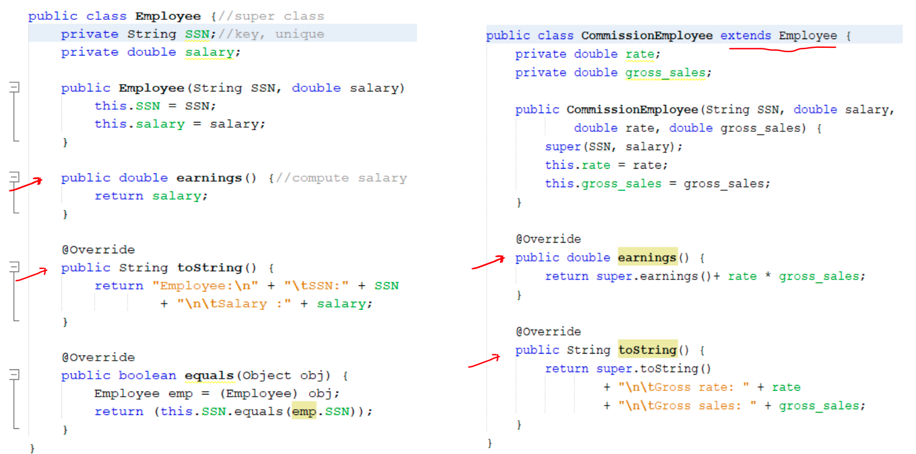

Slide 4
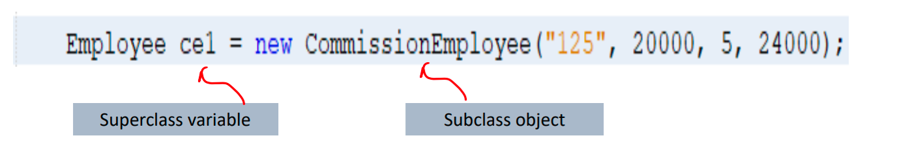
Automatic upcasting – Subclass object referenced as the superclass
Assigning a subclass object to a superclass variable:
This is called automatic upcasting
This is safe because of the is-a relationship
Example:

Slide 5
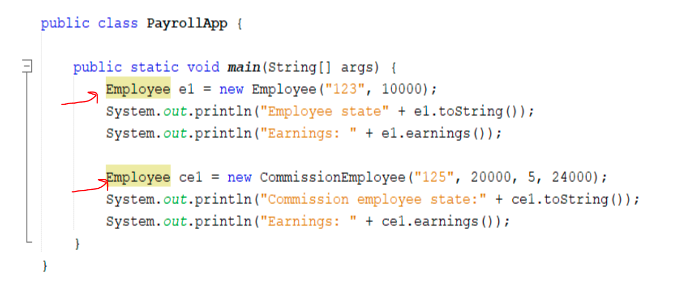
Payroll Application

Slide 6
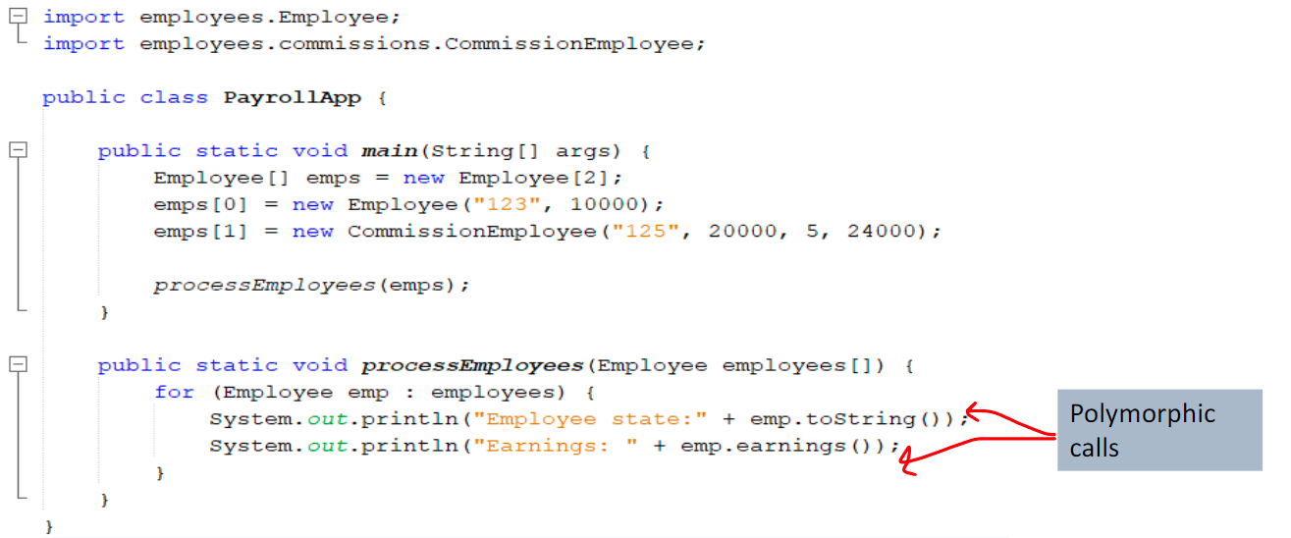
Polymorphic calls

Slide 7
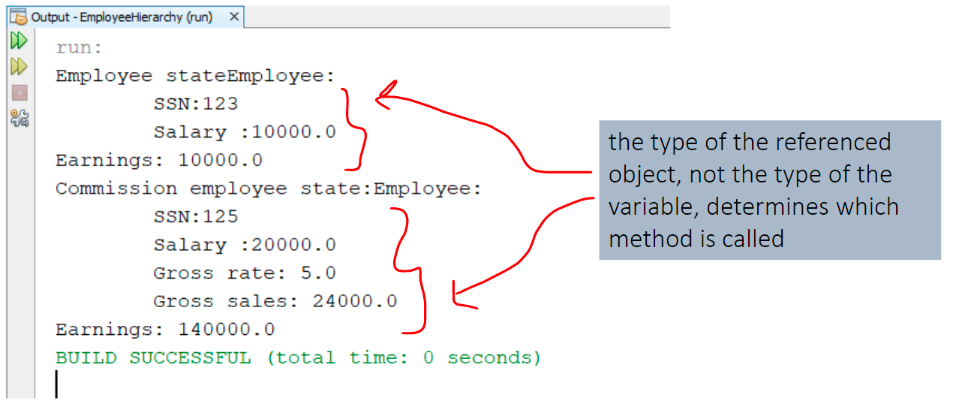
Polymorphic Calls

Slide 8
Polymorphism – Definition
The Java Virtual Machine (JVM) calls the appropriate method for the object that is referred to in each variable
Invoking a method on a subclass object via a superclass reference invokes the subclass functionality
It does not call the method that is defined by the variable’s type.
The type of the references object, not the type of the variable, determines which method is called.
All methods are resolved at runtime, not compile time, this concept is called dynamic binding

Slide 9
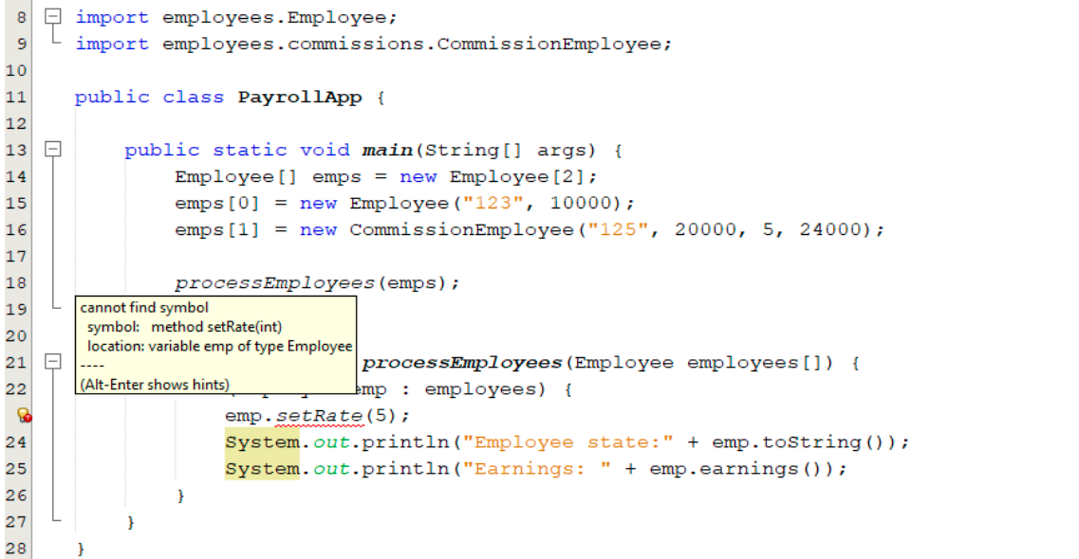
Performing subclass-only operations through superclass variables is a compilation error

Slide 10
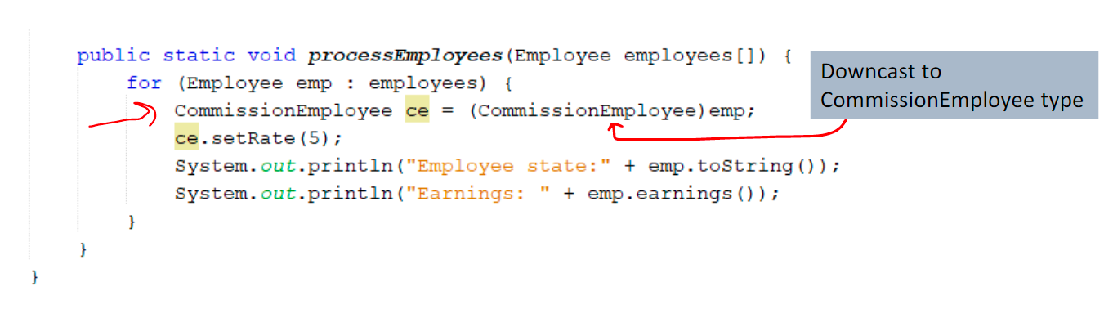
Downcasting
To get around the problem use Downcasting
Convert the reference to a superclass type (emp) into a reference to a subclass type.

Slide 11
Downcasting – ClassCastException
Downcasting is allowed only if the object has an is-a relationship with the subclass type:
When downcasting an object, a ClassCastException occurs, it al runtime the object does not have an is-a relationship with the type specified in the cast operator

Slide 12
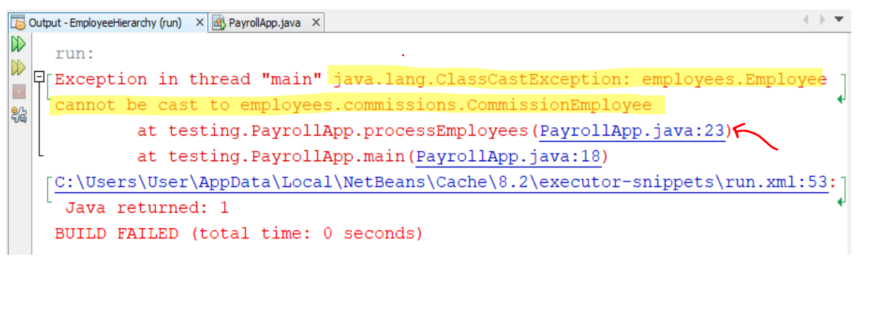
Downcasting – ClassCastException

Slide 13
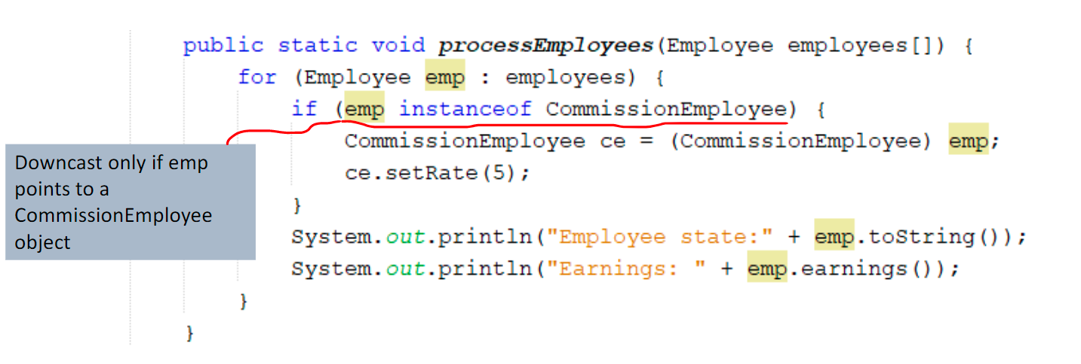
Instanceof operator

Slide 14
Polymorphism – Advantages
Polymorphism enables programmers to deal in generalities and let the execution-time environment handle the specifics
Polymorphism promotes extensibility: Software that invokes polymorphic behavior is independent of the object types to which messages are sent.

Slide 15
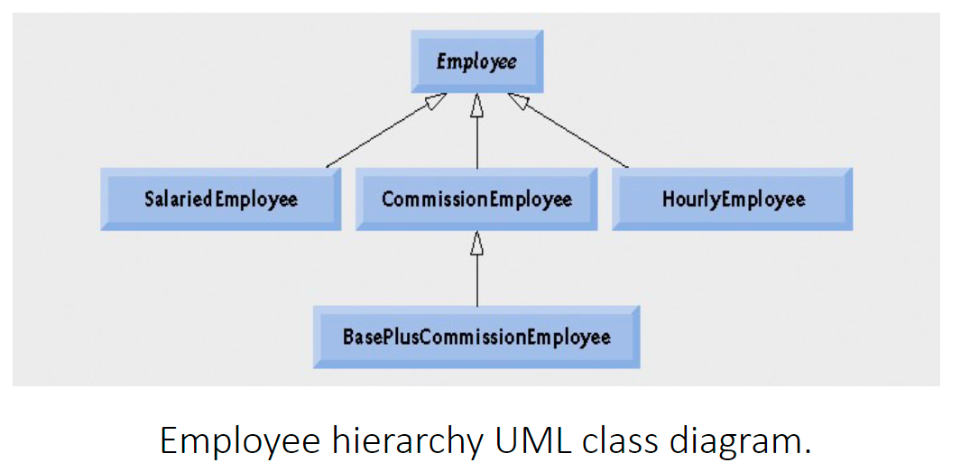
Polymorphism promotes extensibility

Slide 16
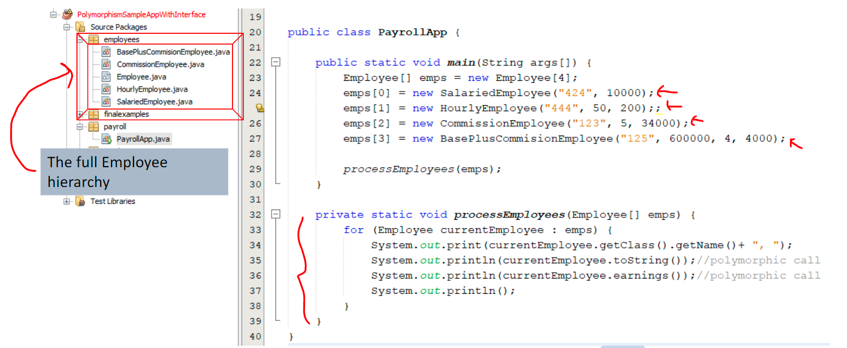
Polymorphism Promotes Extensibility – impact on client code

Slide 17
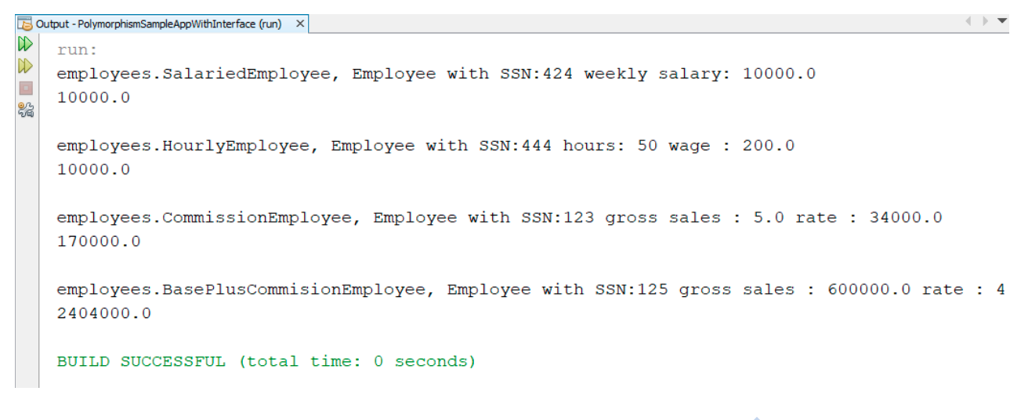
Polymorphism Promotes Extensibility – impact on client code

